Slide 1
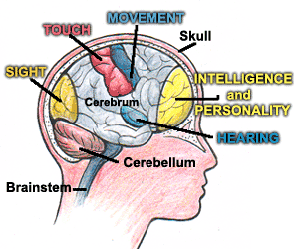
Our Brain OUR THINKING AND FEELING AND DOING MUSCLE.
The brain is a muscle it can stretch and grow. At Ponsonby Primary we know how to look after our brain!
We want our brain to work for us, so we have to do as much learning as we can every day..

Slide 2
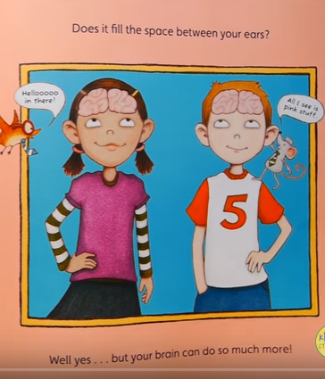
So ask yourselfwhat does your brain do?

Slide 3
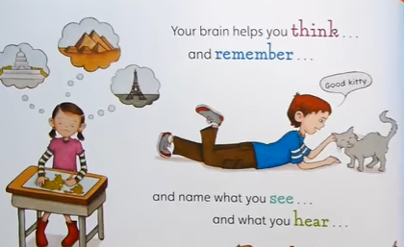
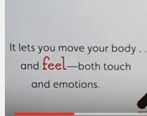
SAD HAPPY FEAR CARING LOVE HATE ANGER JOY EXCITED

Slide 4
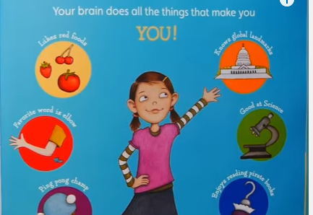
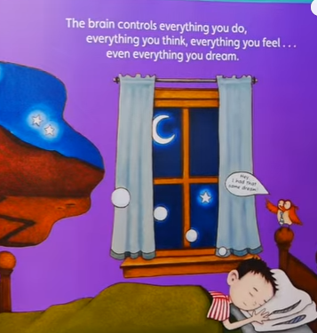
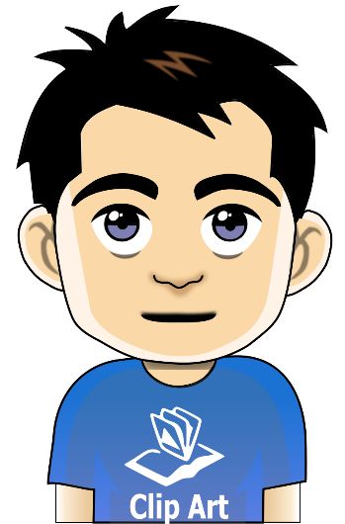
It makes you a REALLY GOOD LEARNER
At night time our brain puts stuff into our long term memory.
6x6=36

Slide 5
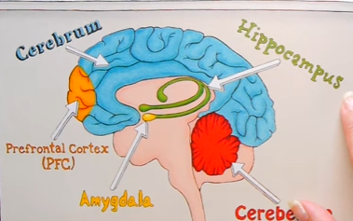
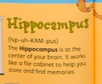
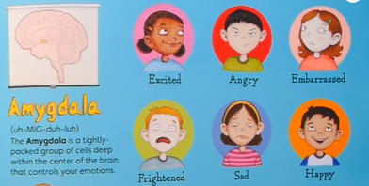
This Cerebrum is our speaking part of the brain
The hippocampus stores memories that we can then access like a library.
THE PFC is the one that helps you plan and make decisions
The cerebellum helps us with learning and knowing how to move…. EG
Standing on one foot
The Amygdala is what controls our emotions.

Slide 6
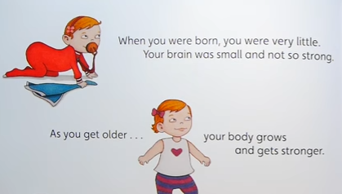
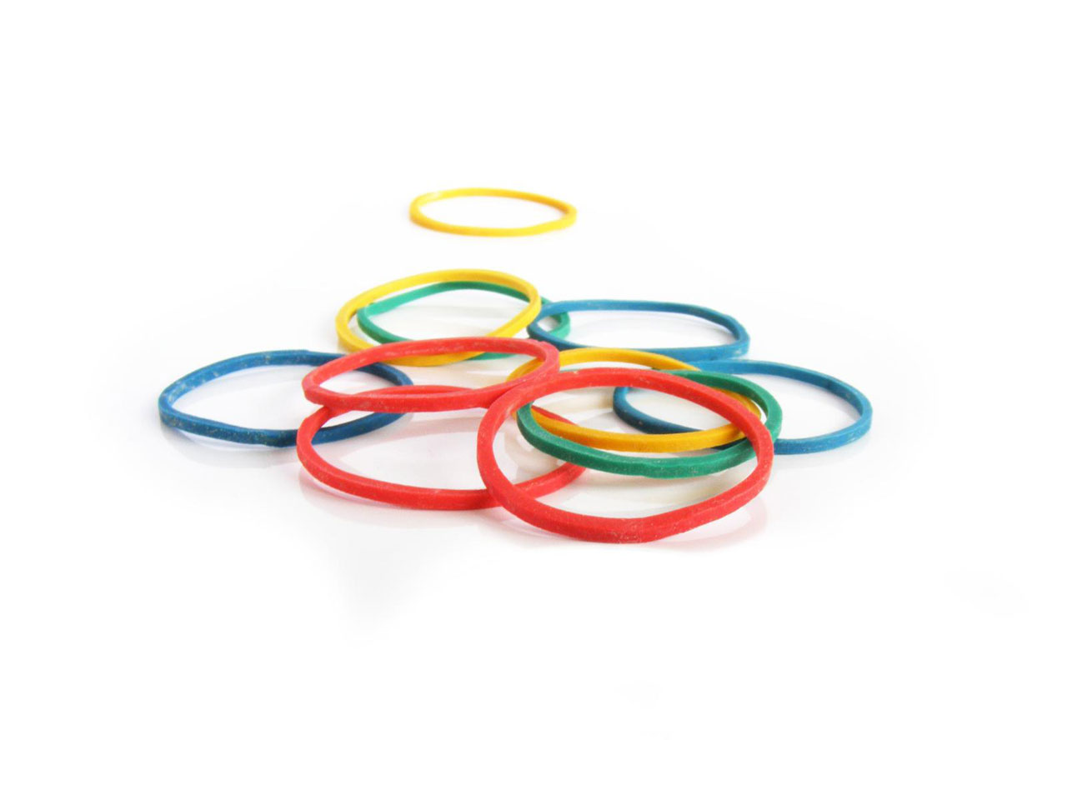
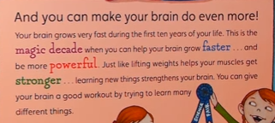
The first 10 years is when you can help your brain
grow faster by learning new things.
The brain is like having 3 rubber bands in your head
We need to stretch our rubber bands

Slide 7
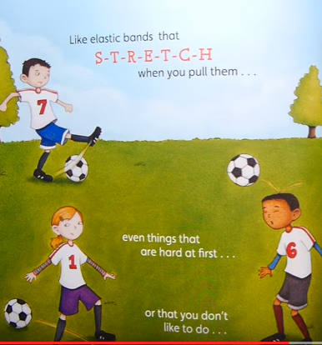

Slide 8
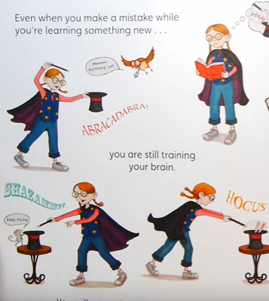
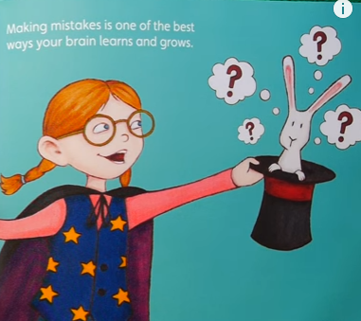
Mistakes help to train your brain

Slide 9
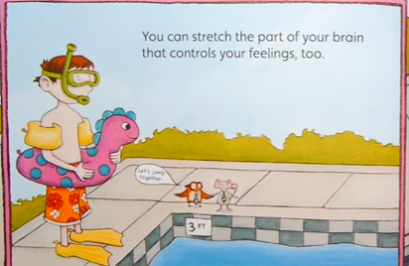
If you are scared of say putting your head under the water. Try it.... Use a bit of courage.. And that will stretch your amygdala!!!!!!

Slide 10
I think you are fabulous Neurosculptors.
Remember the brain is a muscle

Slide 11
