Slide 1
Yes! You
can do it!
It is all about attitude
and giving new things a go.

Slide 2
Never give up!!!
https://www.youtube.com/watch?v=8rxMYX0MoYs Thomas song
https://www.youtube.com/watch?v=A0Gb2fvjKYo Bear
Perseverance noun persistence in doing something despite difficulty or delay in achieving success. "medicine is a field which requires dedication and perseverance" synonyms: persistence, tenacity, determination, resolve, resolution, resoluteness, staying power, purposefulness, firmness of purpose.

Slide 3
Try again

Slide 4
Sometimes change what you do

Slide 5
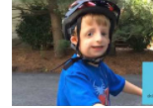
People like Augie in Wonder, just learn to pick up courage and get out there
https://www.youtube.com/watch?v=Ob7fPOzbmzE
Imagine what he felt like on his first day

Slide 6
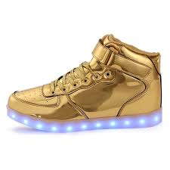
New shoes are a great metaphor for trying something new.

Slide 7
Give it a Go!
We need to challenge ourselves
Think about the movie UP
https://www.youtube.com/watch?v=pkqzFUhGPJg
https://www.youtube.com/watch?v=CevxZvSJLk8
Or Katie Perry’s song Roar

Slide 8
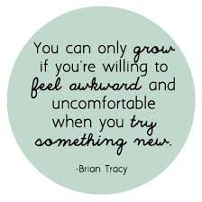

Slide 9
We need to face fears when we try new things

