Slide 1
Online Safety @ PPS

Slide 2
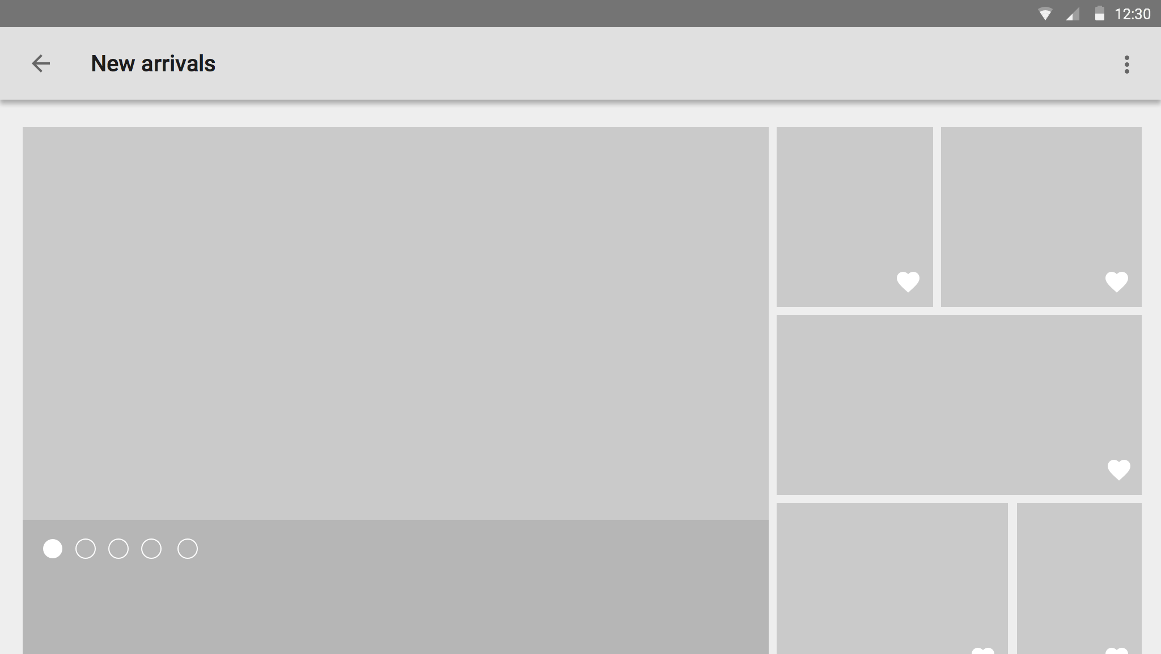
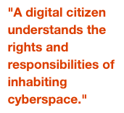
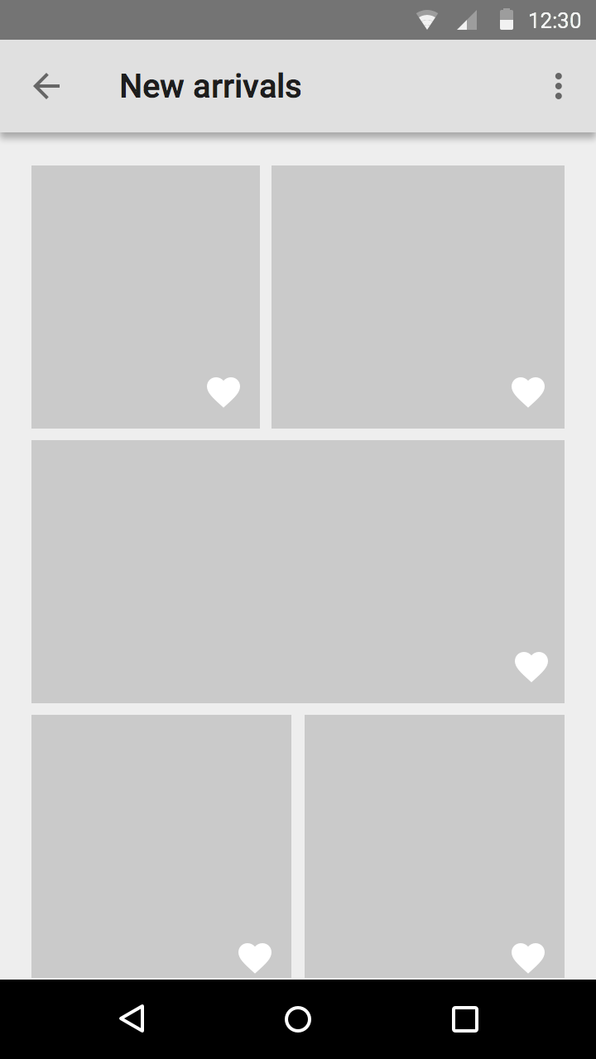
School & home online safety
Today is all about informing you about the actions we take, to ensure online safety when children are at school.
In addition to this, it is to inform you of how to be proactive in monitoring and knowing how to protect your children at home.

Slide 3
What is digital citizenship?
http://elearning.tki.org.nz/Teaching/Digital-citizenship/Digital-citizenship-and-cybersafety
Why teach digital citizenship?
Technology is both the present and the future! New technology is being created daily, and online communication is becoming an increasingly common and important means of building and maintaining connections. Technology in education, job searching, and employment navigation - including meetings and conferences - are just a few among countless ways technology usage and understanding will continue to be major tools of success as students continue their educational journeys and ultimately venture out into the workforce. Teaching digital citizenship equips students with the knowledge, skills and resources to succeed as lifetime learners, and also helps them learn to engage within a digital environment with responsibility and confidence to develop as leaders who will leave meaningful impacts in the lives of others.

Slide 4
What Ponsonby already uses.
Google Safe Search is a feature which is an automated filter, it removes anything ‘highly offensive’. This works for our students when they are on the school wifi. ‘PPS BYOD’

Slide 5
We are exploring a possible partner school programme to allow even more rigorous monitoring and the ability to block sites, social media, detects VPNs and words as they emerge in the digital world.

Slide 6
Family Zone for school and home promises every student safe on every device
Parents can set rest-days, times of use, calendar school days. You can get parent reports. Mobile devices can also be part of this safe home for kids.
The retail cost is $76.00. For a family pack of 6 licenses that can be applied to any 6 devices A school discount amount of $59.00 GST Inclusive.
Or
School buys the home licenses (1 for nearly every family. We have 235 families we know some might not want this so this is calculated on 215 licenses. So the commit has to be 1 license per family to get this costing ) for $45.00 for a home for 6 devices and that also then funds fully the school zone.
School then sets the school day on each child’s calendar and has high notification capability.

Slide 7
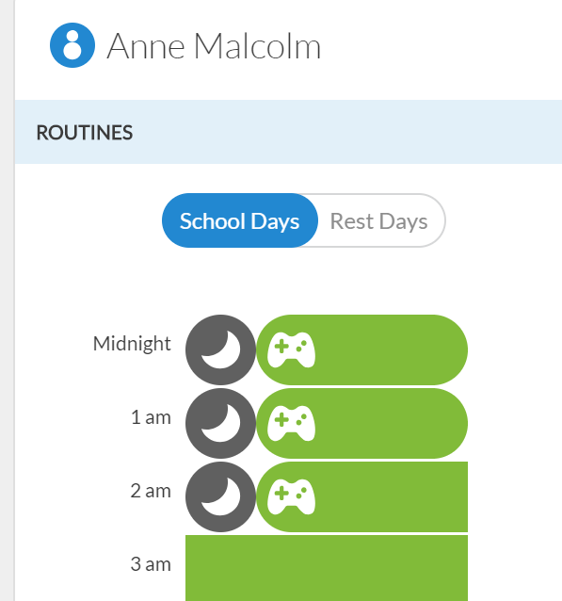
Home zone free trial

