Slide 1
Parenting Connected Kids
Steve Voisey

Slide 2
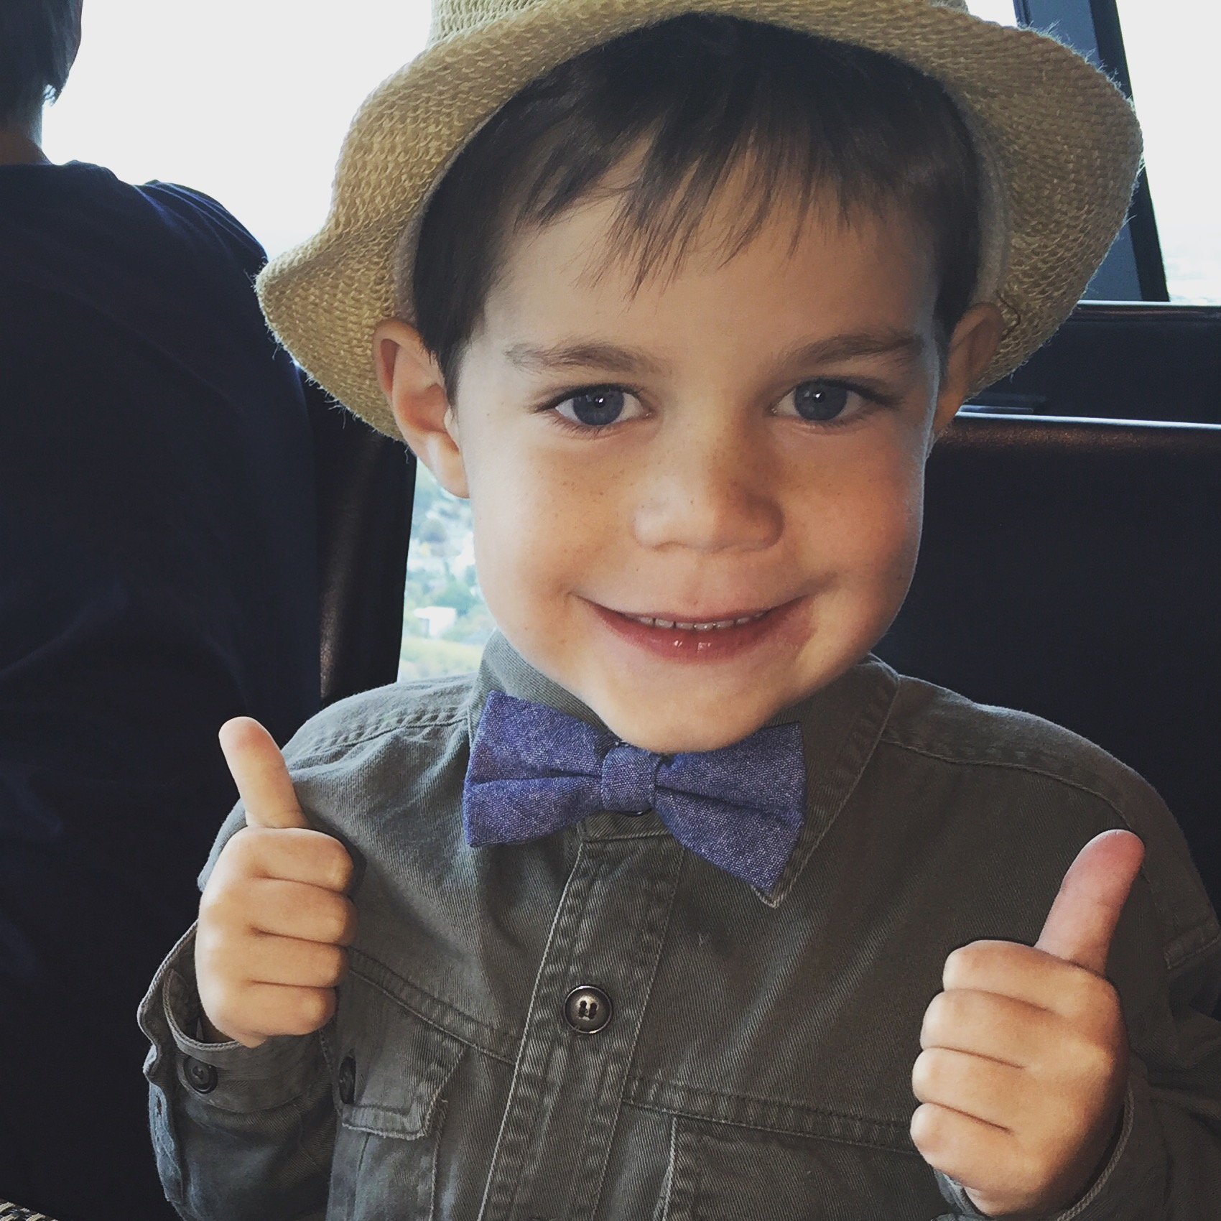
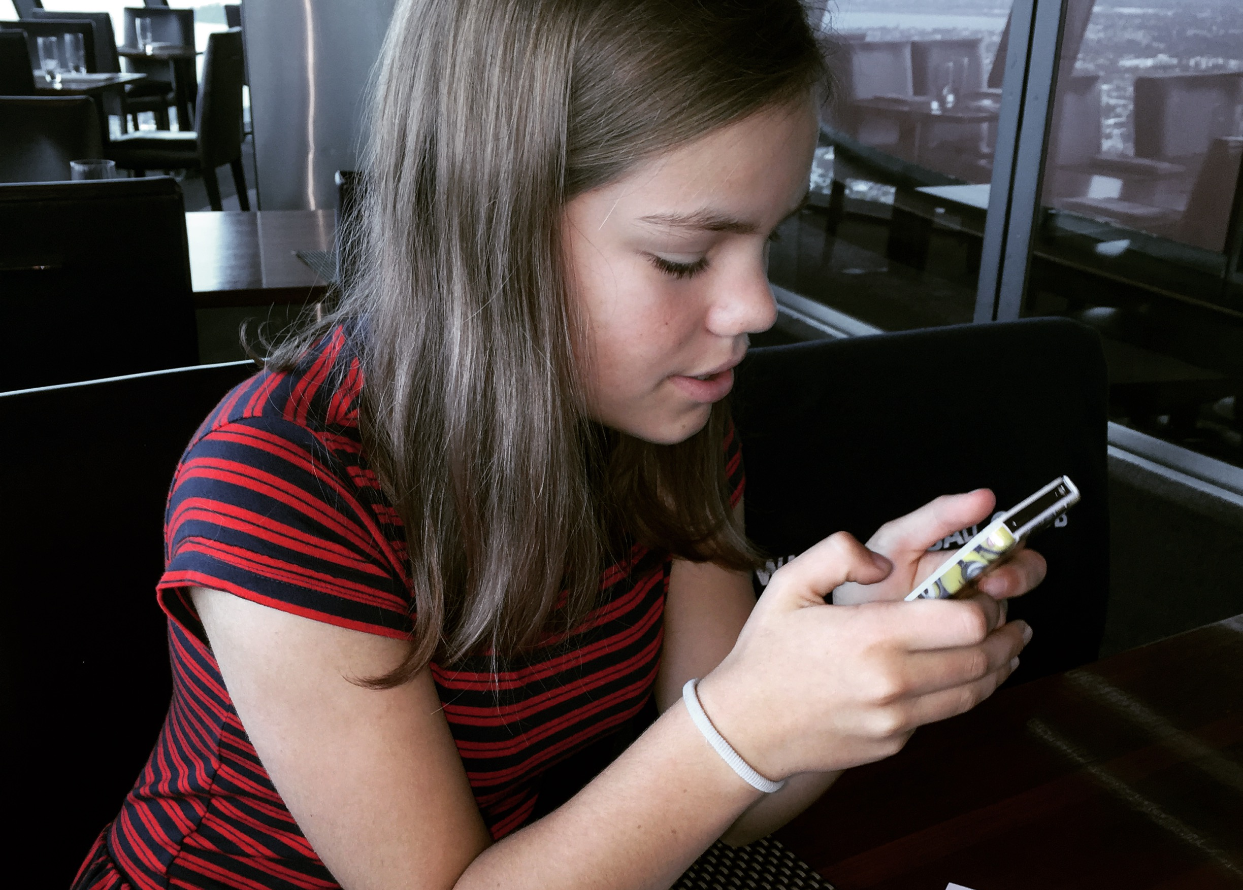
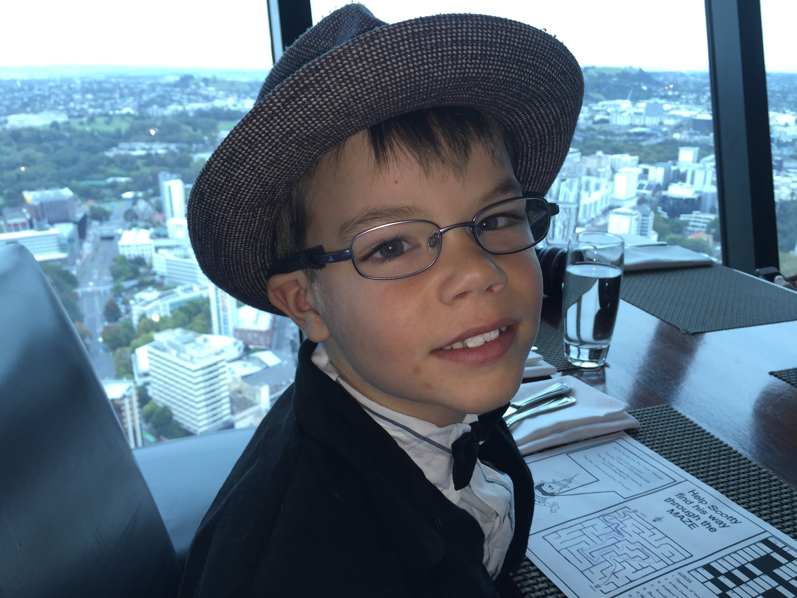

Slide 3
Technical tools
Understanding browsing history (incognito/private mode)
Parental controls (Apple family)
At school: ministry-funded filtering

Slide 4
Netsafe’s tips for parents
Set Expectations
Understand what they do online
If you don’t understand it, TRY IT
Set a good example
Teach them the basics
Setting up social media
Give them the tools they need
Online bullying
What if something does happen?

